Slide 1







FUTURE IT SKILLS
OMER JADALLAH
Friday, April 19, 2024

Slide 2



OUTLINE
Executive Summary
Introduction
Methodology
Results
Visualization – Charts
Dashboard
Discussion
Findings & Implications
Conclusion
Appendix

Slide 3

EXECUTIVE SUMMARY
In order to keep pace with changing technologies and remain competitive, organization regularly analyzes data to help identify future skill requirements.
The data has been collected for the top programming skills that are most in demand from various sources including:
Job postings
Training portals
Surveys
Exploratory Data Analysis (EDA) is conducted to find the distribution of data, presence of outliers and the correlation between different variables.
Data has been visualized using various charts.

Slide 4

INTRODUCTION
The objective of the report is to provide IT consultants in ABC IT Solutions Company with Descriptive Data Analysis on data from various sources and identifying trends for this year's on emerging IT skills.
In order to keep pace with changing technologies and remain competitive, organizations need to regularly analyzes data to help identify future skill requirements.
Questions to be answered
What are the top programming languages in demand?
What are the top database skills in demand?
What are the popular IDEs?

Slide 5

METHODOLOGY
The data has been collected for the top programming skills that are most in demand from various sources including:
Job postings
Training portals
Surveys
Prior to analysis, the dataset undergoes thorough preprocessing to ensure data quality and consistency. This includes:
Removal of duplicate records and irrelevant variables.
Handling missing values through imputation or exclusion.
Standardization or normalization of numerical features.
Encoding categorical variables using techniques such as one-hot encoding or label encoding.
Exploratory Data Analysis (EDA) is conducted to find the distribution of data, presence of outliers and the correlation between different variables.

Slide 6
RESULTS

Slide 7
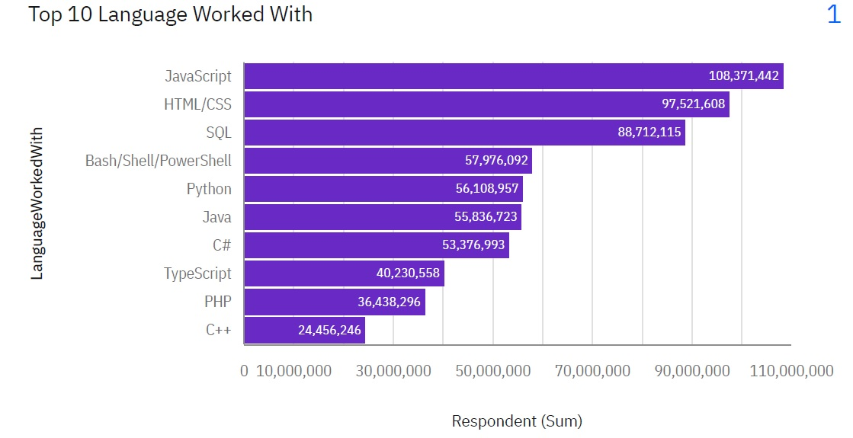
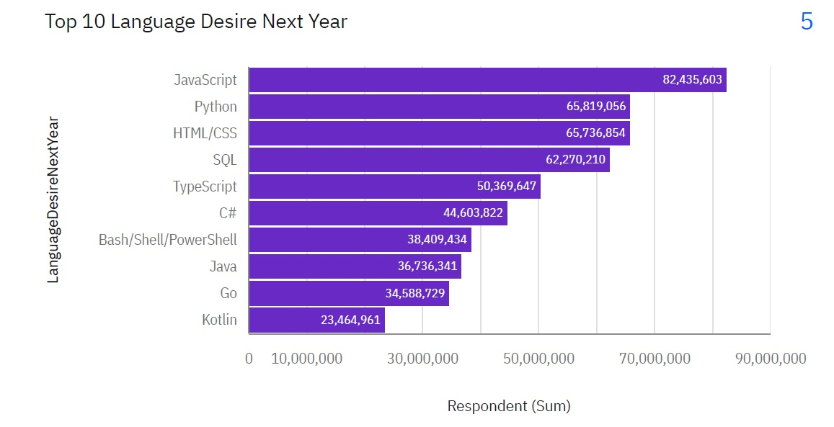
PROGRAMMING LANGUAGE TRENDS
Current Year
Next Year

Slide 8
PROGRAMMING LANGUAGE TRENDS - FINDINGS & IMPLICATIONS
Findings
JavaScript is the most worked with language in this year and also the most desired in the next year.
Python advanced to be in the 2nd rank of most desired language.
Python is growing and will be on the top after JavaScript next year.
C++ is the least worked with language in this year.
C++ and PHP are in the bottom of the list this year and might not be in the list of top 10 desired languages.
Implications
JavaScript will be dominant for a while in the future.
Python is growing language.
Some languages will no be desired to work with in the next year.
New languages will be in the list next year like Kotlin and Go.

Slide 9
PROGRAMMING LANGUAGE TRENDS - FINDINGS & IMPLICATIONS
Findings
JavaScript is the most worked with language in this year and also the most desired in the next year.
Python is growing and will be on the top after JavaScript.
C++ is the least worked with language in this year.
Some languages will no be desired to work with in the next year like C++ and PHP.
New languages will be in the list next year like Kotlin and Go.
Implications
JavaScript will be dominant for a while in the future.
Machine learning and artificial intelligence market is growing which in turn advanced the rank of python, the most preferred language in this field
Mobile Apps development is evolving and languages like Kotlin and Go will compete in the future.

Slide 10
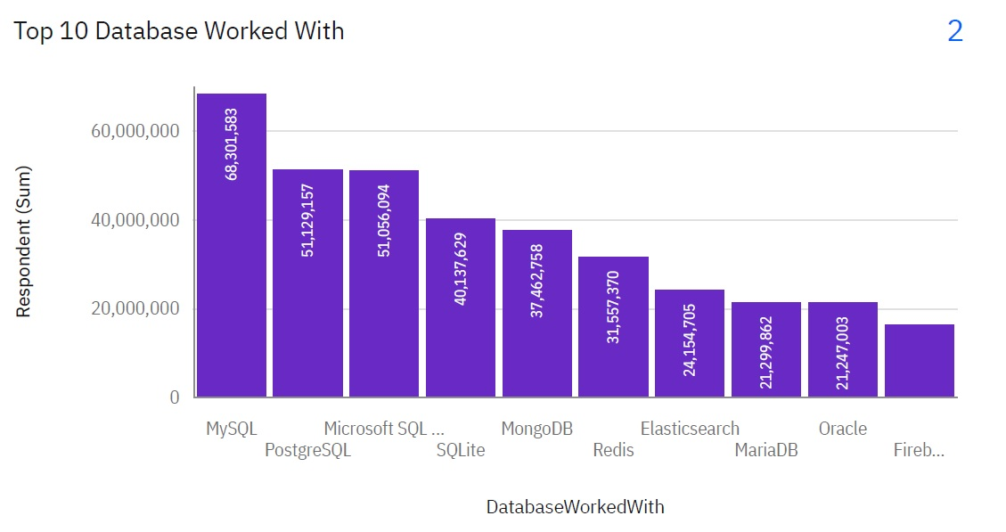
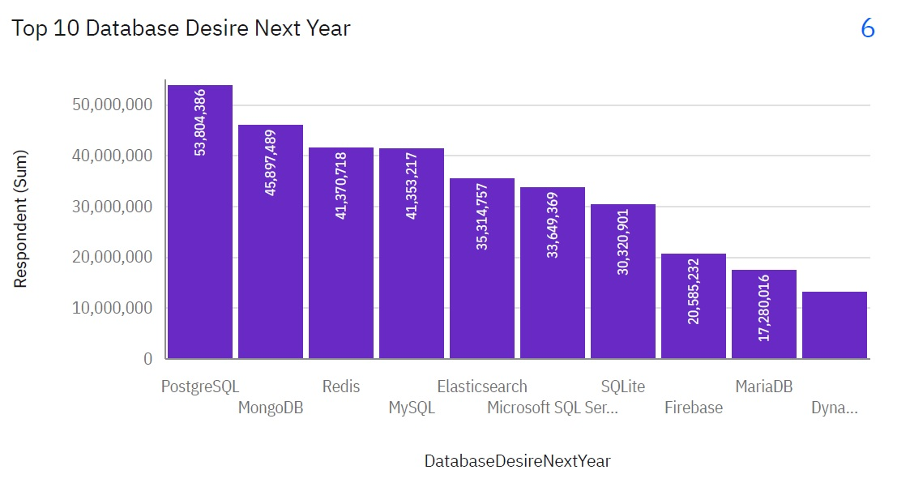
DATABASE TRENDS
Current Year
Next Year

Slide 11
DATABASE TRENDS - FINDINGS & IMPLICATIONS
Findings
MySQL is the most worked with database in the current year.
PostgreSQL will be the most desired database in the next year.
MongoDB and Redis advanced in the rank of desired databases next year.
All the databases in this year will be on the list of next year except Oracle which has been replaced by DynamoDB.
Implications
The open sources databases are more preferred in the future as we have seen the advance of PostgreSQL and MongoDB.
Oracle is no longer in the top 10 preferred databases.

Slide 12
DATABASE TRENDS - FINDINGS & IMPLICATIONS
Findings
MySQL is the most worked with database in the current year.
PostgreSQL will be the most desired database in the next year.
MongoDB and Redis advanced in the rank of desired databases next year.
Implications
PostgreSQL and MongoDB will be in the top of the 10 databases next year.
Oracle is no longer in the top 10 preferred databases.

Slide 13

DASHBOARD
https://github.com/OmerAlhaj/python-data-analytics.git

Slide 14
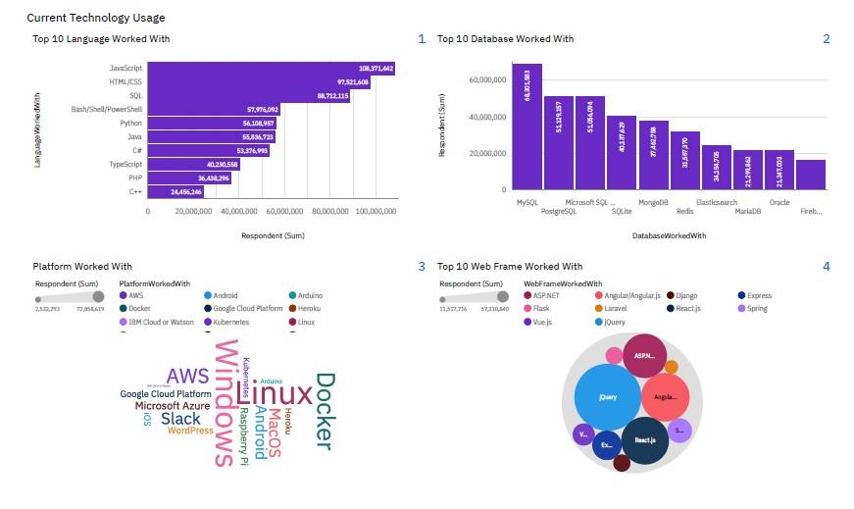
DASHBOARD TAB 1

Slide 15
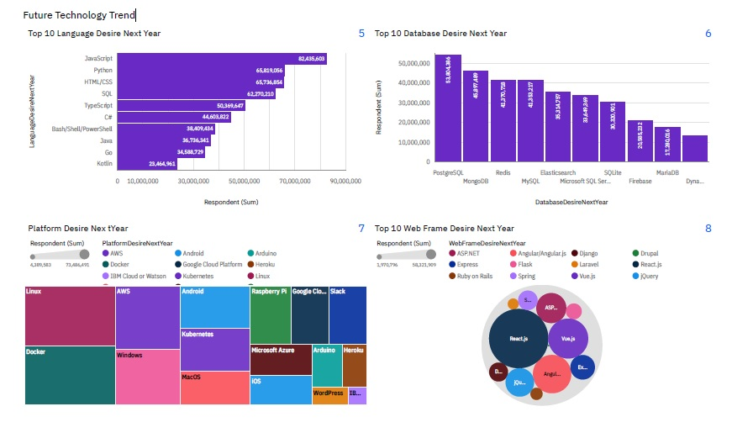
DASHBOARD TAB 2

Slide 16
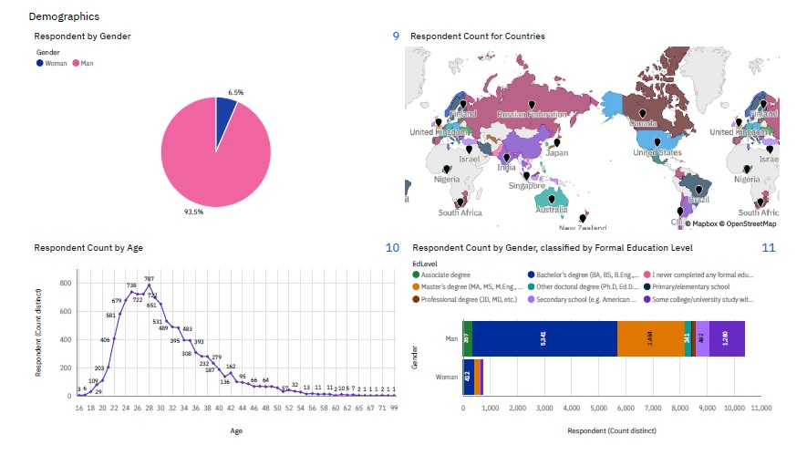
DASHBOARD TAB 3

Slide 17
DISCUSSION
Why JavaScript will be dominant.
Why python is growing? And its relation with the growing market of machine learning and AI?
Why Kotlin and Go languages appeared in the top 10 list of desired languages?
Why PostgreSQL and MongoDb will be on the top of the list of desired databases next Year?
Why oracle might no longer be in the top 10 databases next year? And its relation with the open sources and enterprises databases?

Slide 18
OVERALL FINDINGS & IMPLICATIONS
Findings
JavaScript is the most worked with language in this year and also the most desired in the next year.
Some languages will no be desired to work with in the next year like C++ and PHP.
New languages will be in the list next year like Kotlin and Go.
MySQL is the most worked with database in the current year.
PostgreSQL will be the most desired database in the next year.
All the databases in this year will be on the list of next year except Oracle which has been replaced by DynamoDB.
Implications
New Languages will rise in the future due to the evolving market of AI and Machine Learning.
No significant change in the top 10 databases worked with in the next year.

Slide 19

CONCLUSION
This report focused on performing Descriptive Data Analysis on data from various sources and identifying trends for this year's on emerging IT skills.
The top 10 languages in demand are JavaScript, Python, HTML/CSS, SQL, TypeScript, C#, Bash/Shell/PowerShell, Java, Go, Kotlin.
The top 10 databases in demand are PostgreSQL, MongoDB, Redis, MySQL, Elasticsearch, Microsoft SQL Server, SQLite, Firebase, MariaDB, DynamoDB.

Slide 20
APPENDIX

Slide 21
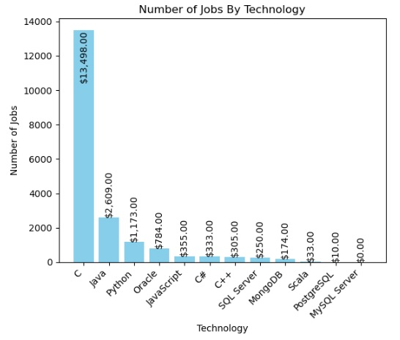
JOB POSTINGS

Slide 22
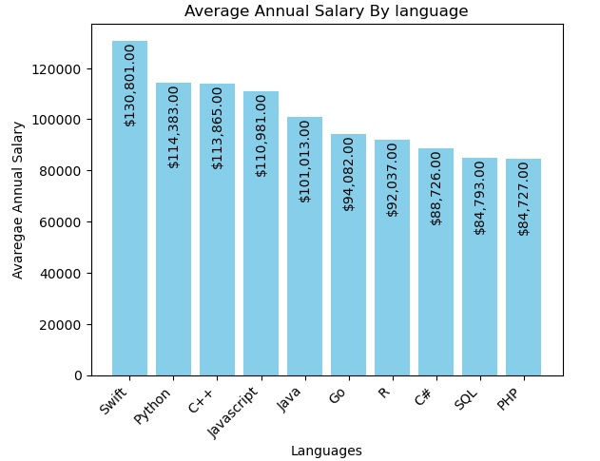
POPULAR LANGUAGES

